Slide 1
Interest Processing in CMS

Slide 2
Topics Covered
Parameters defined at certain levels
Pre-interest and Post-interest Processing
Calculating of various fields required for interest billing
Interest calculation formula
Waiving of interest with a payment

Slide 3
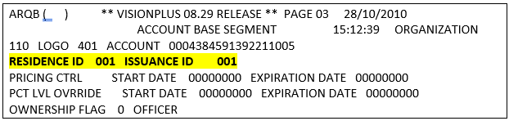
How to identify interest table of the card holder
There are several parameters involved to decide interest table.
1. Processing Control Table
2. Logo Record
3. Credit Plan Master Record
Processing Control Table:
If an account is in a private label retail logo, its PCT ID is the RESIDENCE ID field from ARMB03 screen.
If an account is in a bankcard logo, its PCT ID is the ISSUANCE ID field from ARMB03 Screen.

Slide 4
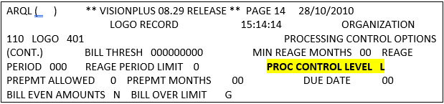
Logo Record:
It decides whether processing for the logo is at Org level or Logo level in the ARML14 page.

Slide 5
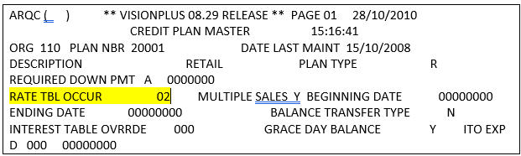

Credit Plan Master Record:
It decides occurrence of rate table.
Present the PCT ID value in ARMF screen to know interest table of card holder.

Slide 6
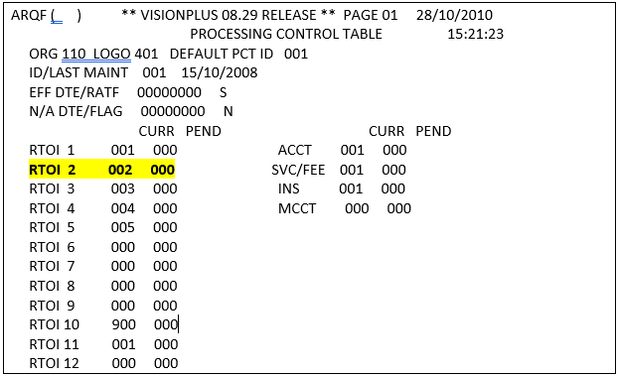

Slide 7

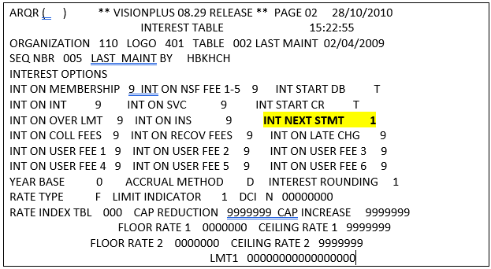
Interest table of card holder is “002” as RTOI is “2”.

Slide 8
Related Fields:
Include/Exclude B-N-P Components:
In CMS, interest calculations need not be performed on the entire credit plan balance. Using the flags at the top of the Interest Table, you can specify which billed-not-paid components of the plan’s balance will comprise the plan’s Balance Subject to Finance Charges (BSTFC).
INT ON INT : 0 → Don’t charge Interest on Interest
1 → Charge Interest on Interest
9 → Don’t charge interest on CTD Interest
Interest Start Debit and Interest Start Credit:
Which determines when interest calculations will begin on debit / credit transactions.
INT START DB: S → Cycle Date
T → Effective date of Transaction
P → Posting date of transaction
INT START CR: T → Effective date of Transaction
P → Posting date of transaction
Interest Next Statement
The INT NEXT STMT field controls how CMS processes interest on new debits posted during a billing cycle. This field provides additional controls beyond grace days processing. It is used to waive, charge, or defer interest on new debits in specific circumstances

Slide 10
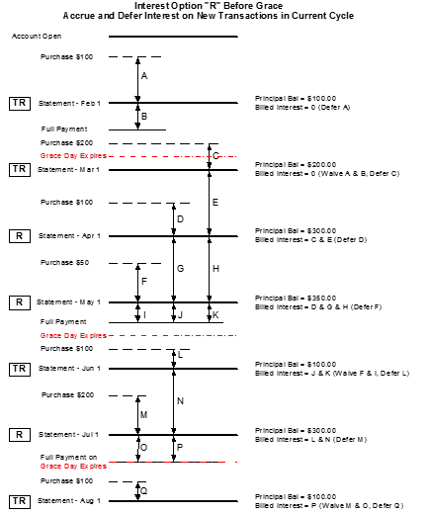

Slide 11
Accrual Method:
The ACCRUAL METHOD specifies whether interest will accrue on the plan either daily or monthly. In additional to standard monthly accrual, CMS offers a “monthly adjusted ending” option.
Using the daily accrual method, CMS updates the aggregate BSTFC and accrued interest fields on the plan segment during each processing run. At cycle close, the system bills the accrued interest to the account.
Using the monthly method, CMS accrues no interest on the plan segment. At the cycle close, the system calculates the Average Daily Balance (the aggregate BSTFC divided by the number of days in the cycle) and applies the interest rate to it. The monthly accrual method requires a year base of 360 days.
Year Base:
The YEAR BASE code specifies the base number of days in the year to be used in computing interest on plan segments subject to this Interest Table.
0 → Actual 365 or 366 days
1 → Fixed 365 days
2 → Fixed 360 days

Slide 12
Rounding of Interest Calculations
Code that indicates the rounding method CMS uses to round or truncate interest calculations. Rounding is based on the currency NOD and the number that follows the last decimal in the currency
0 → Standard rounding (If the number that follows the last decimal in the currency is 1 to 4, CMS rounds down; if the number is 5 to 9, CMS rounds up)
1 → Always round up (If the number is 1 to 9, CMS rounds up)
2 → Truncate (CMS does not round).
Example 1: If the currency NOD is 2 and the calculated amount is $66.374, the number that follows the last decimal in the currency is 4. CMS rounds or truncates the calculated amount as follows:
Standard rounding (value 0) = $66.37 Round up (value 1) = $66.38 Truncate (value 2) = $66.37

Slide 13
Limit Indicator:
This field instructs CMS on how to use the tier limits for tiered and tiered variable rates. If you select option 0, the system will apply a different interest rate to each portion of the balance that falls into a tier range. If you select option 1, the system will apply one rate based on where the total balance falls in the tier ranges.
Example: The following example illustrates how the LIMIT INDICATOR works. Assume that a plan segment has a balance of $2,500. Tiers have been set up as follows:
Rate 1 1350000 Limit 1 00000000000001000
Rate 2 1150000 Limit 2 00000000000002000
Rate 3 0950000 Limit 3 00000000000003000
If the LIMIT INDICATOR is set to 0, the system will apply a rate of 13.5% to the first $1000 of the balance, a rate of 11.5% to the second $1,000, and a rate of 9.5% to the remaining $500.
If the LIMIT INDICATOR is set to 1, however, the system will apply a rate of 9.5% to the entire balance.

Slide 14
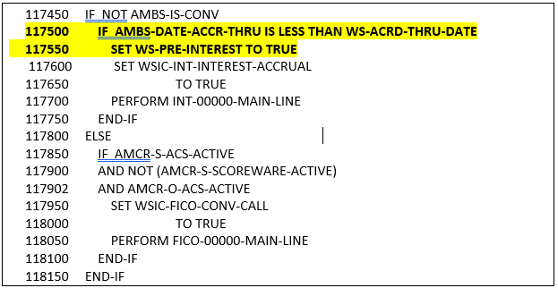
ARD140 processing
Pre-interest processing:
Pre-interest processing is done before posting of any ATPT transactions. This is done to update the plan interest if AMBS-DATE-ACCR-THRU is less than the (today’s Julian – 1) days i.e. during last run of the ARD140, account accrual did not occur till the next processing date. Pre-interest processing updates the interest buckets before processing the account transactions.

Slide 15
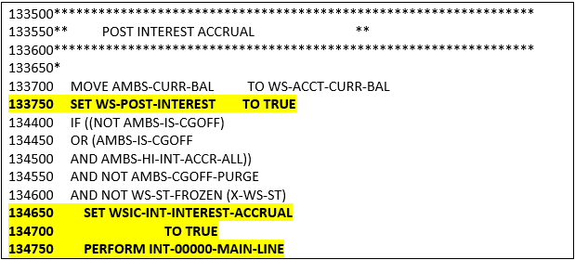
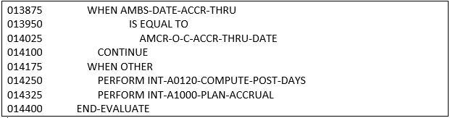
ARD140 processing
Post-interest processing:
Post-interest processing takes place after ATPT transactions are posted for the account.
Here, post interest conditions are validated and respective code is performed.

Slide 16
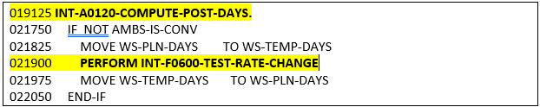
ARD140 processing
Note in above, if AMBS account accrue through date is matching to org accrue through date, then it would reflect that interest was already accrued on the account in last cycle.
During normal scenario, at this point AMBS-DATE-ACCR-THRU will contain date less than the AMCR-O-C-ACCR-THRU-DATE.
So, before accruing interest, number of days for which interest needs to be assessed from last accrue date is calculated in this Para.
Which also checks is there any rate change compared to yesterday, if yes posting uses new rates.

Slide 17
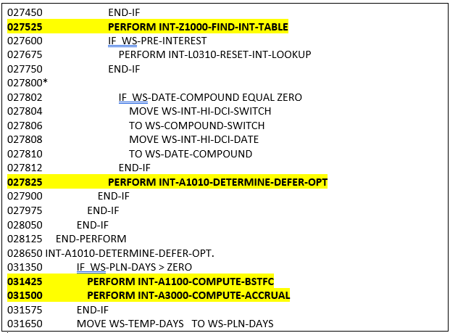
ARD140 processing
After calculation of WS-PLN-DAYS, plan accrual begins.
In this Para interest table is searched to find the rate of interest and call one more para to calculate BSTFC.

Slide 18
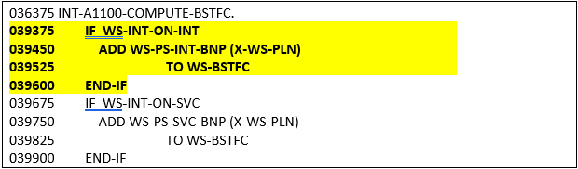
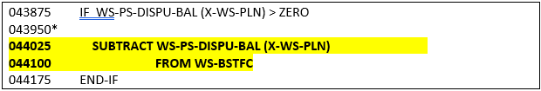
ARD140 processing
While Calculating BSTFC it adds to it depends on ARQR settings.
BSTFC = principle amount + BNP’s
Please note that Dispute amount will not be included in the BSTFC.

Slide 19
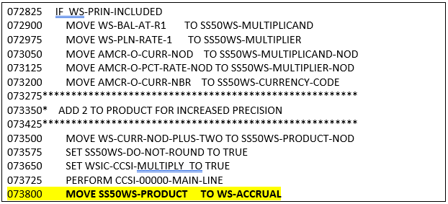
ARD140 processing
Once BSTFC calculation is done, accrued interest is calculated.
If performing daily accrual, (ACCRUAL METHOD = D on ARQR), then INT-A3300-DAILY-ACCRUAL is performed.
INT-A3320-SELECT-YEAR-BASE – here appropriate year base is selected. The number of days pertaining to Year base value will be used as divider to calculate rate/day.
Interest will be calculated using below formulae:
Interest = BSTFC * rate of interest * year base
Calculated Interest will be add up with the Accrued interest and move to AMPS-INT-PER-DIEM.

Slide 20
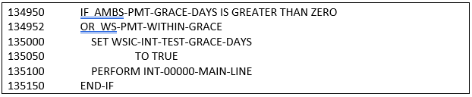
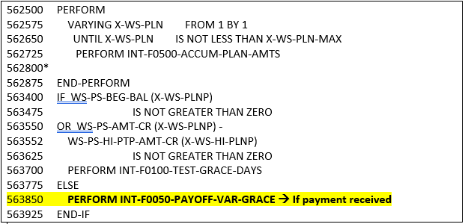
Interest Waive with Payment:
Post Interest Accrual system will verify for full payment, if received it will set Grace Paid in full and also waive the Deferred Interest from last cycle.
In Test Grace Day’s para, it accumulates all the plan buckets and compare with the AMBS-QUAL-GRACE-BAL. If Sum of the credits of all plans is greater than requested amount, then it will waive the deferred interest.

Slide 21
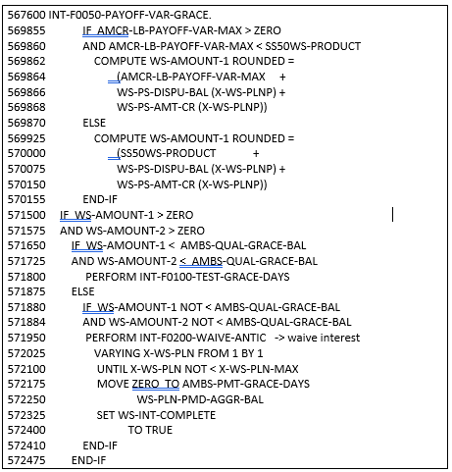

Slide 22
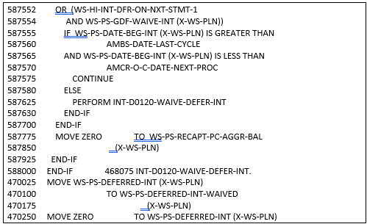

Slide 23
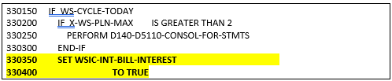

Interest Billing:
Finance charge will be billed on cycled day after lots of validations for waving & deferring.
While interest billing system will below validations to waive & bill accrued interest.

Slide 24
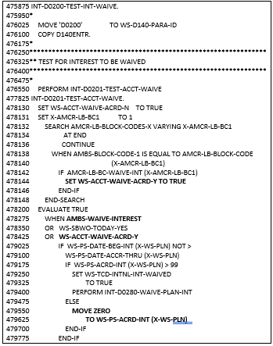
System checks for whether any block code present at account level and it has interest waive at logo level and also check for any account level interest waive flag. If any of both mentioned is present system will waive interest accrued in that cycle.

Slide 25
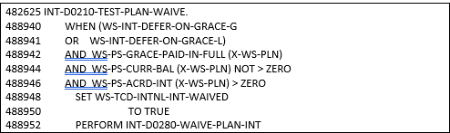
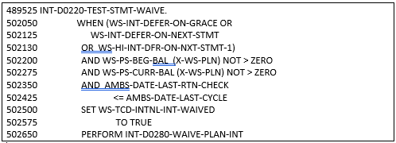
If Accrued interest is still available after first validation then system checks whether payment
received with in grace, if received they accrued interest will waived.
If Accrued interest is still available after First & Second validation then system checks whether beginning balance of account less than ZERO and waive the accrued interest for interest option G.

Slide 26
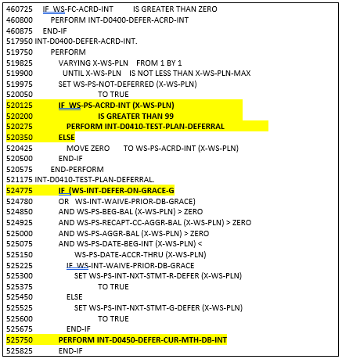
If still Accrued interest in pending after above waives process, system will initially defer the current cycle accrued interest.

Slide 27
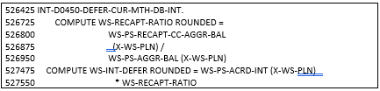
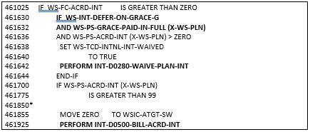
System calculates the current month debits accrued interest by using Recap Ration and it will be calculated from RECAPT-CC-AGGR-BAL and AGGR-BAL. Calculated Defer amount will be moved to AMPS Defer bucket.
If still interest accrued interest (Prior cycle debit accrued interest) is pending even after above processes, system validate whether payment received with in grace or not. If received system will waive the Accrued interest on prior cycle debits else interest will be bill to customers.

